Slide 1


DETECTION OF CYBERBULLYING ON REDDIT COMMENTS
Akshya Ramesh
Rathnapriya Gopalakrishnan

Slide 2
CYBERBULLYING
An individual or group of individuals harassing a person through the use of electronic communication devices.
It includes sending and sharing, negative, offensive or hurtful comments.
This can be harmful to the victims causing stress, anxiety, depression and low-self esteem.

Slide 3
PROBLEM STATEMENT
Identifying and labelling of reddit comments as cyberbullying or non-cyberbullying using NLP and predicting the same using Machine Learning

Slide 4
CYBER-BULLYING VS NOT CYBER-BULLYING
Not cyberbullying
This is so fucking good. You are a fucking genius. This is such a good idea man. You are amazing..!!
Cyberbullying
You disgusting piece of shit. Go fuck yourself you motherfucker.

Slide 5
REDDIT DATA
ABUSIVE WORDS DATA
Data: https://www.kaggle.com/datasets/smagnan/1-million-reddit-comments-from-40-subreddits
Data Source: Kaggle
Record Count: 1 million
Data Description:
Subreddit category
Comment
Data:
https://github.com/surge-ai/profanity/blob/main/profanity_en.csv
Data Source: Github
Record Count: 1598

Slide 6
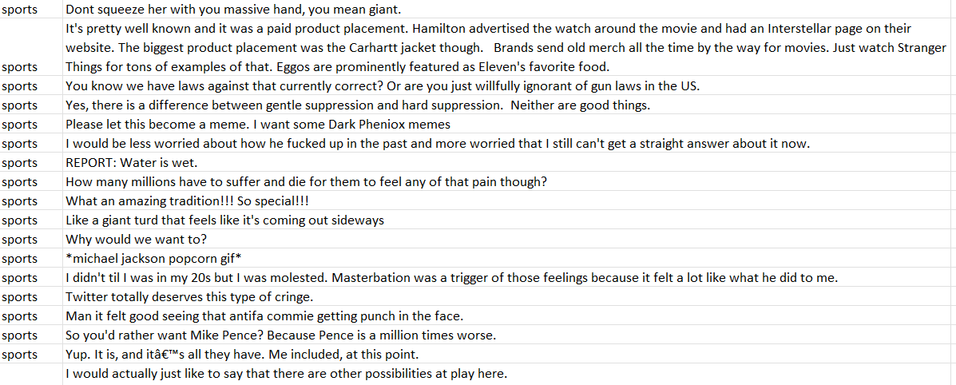
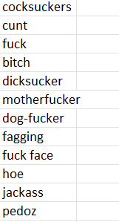
REDDIT DATA
BAD WORD DATA

Slide 7
PROCESS
TOOLS
Data Collection and storage
Data Cleaning
Labelling
Sentiment Analysis
Offensiveness Proportion
Feature Engineering
Machine Learning
Google Cloud Services
Pyspark
NLTK
SparkML

Slide 8
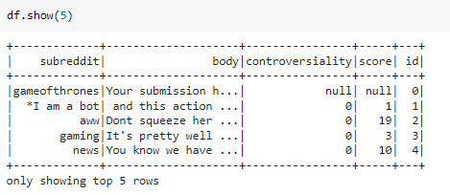
ORIGINAL DATAFRAME

Slide 9
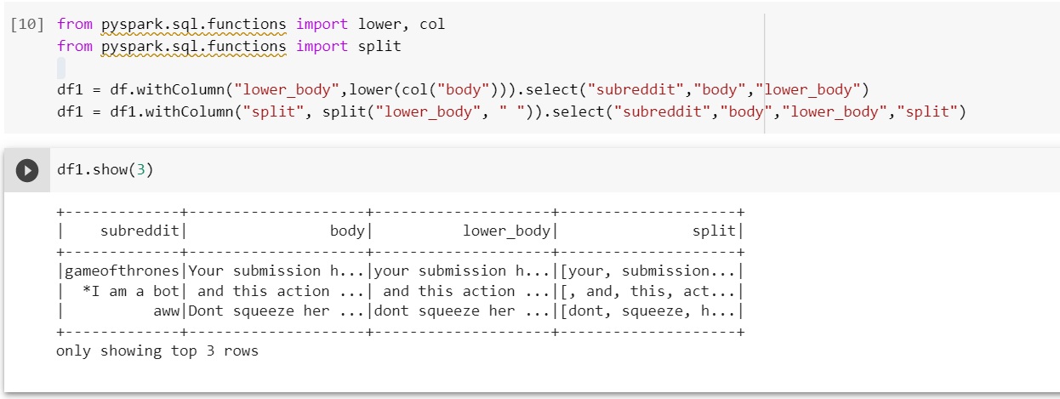
TOKENIZATION

Slide 10
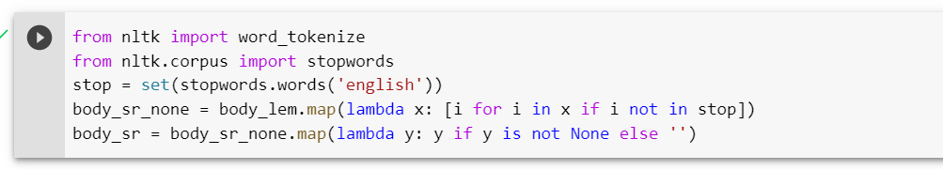
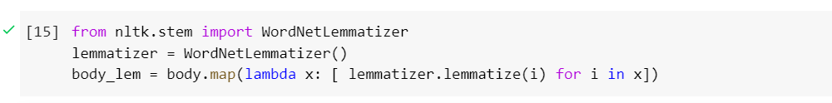
STOP WORDS REMOVAL
LEMMATIZATION

Slide 11
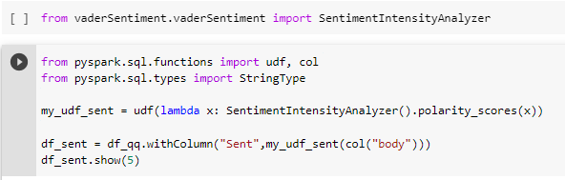
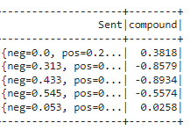

SENTIMENT ANALYSIS

Slide 12
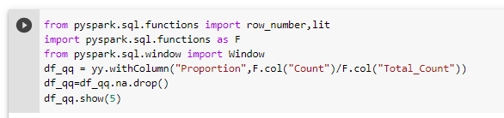
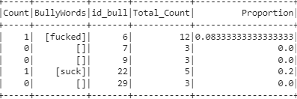
OFFENSIVENESS PROPORTION

Slide 13
Labelling Algorithm
Sentiment | Offensiveness Proportion | Label
Positive / Neutral | < Threshold | Non Cyberbullying
Positive | > Threshold | Non Cyberbullying
Negative | > Threshold | Cyberbullying
Neutral | > 0.5 | Cyberbullying

Slide 14
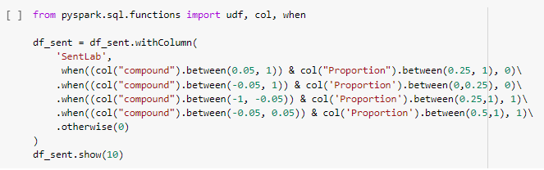
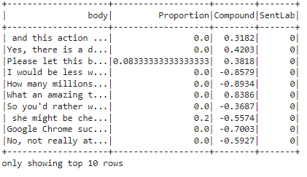
LABELLING

Slide 15
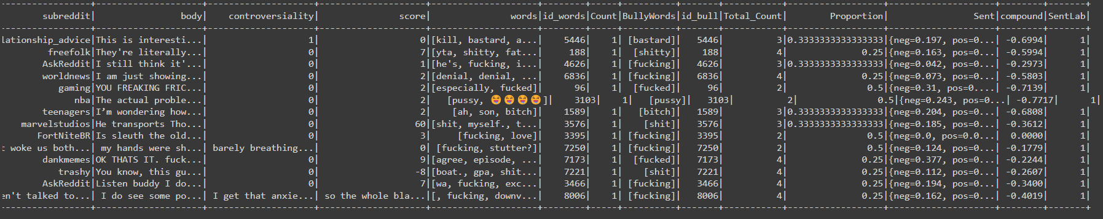
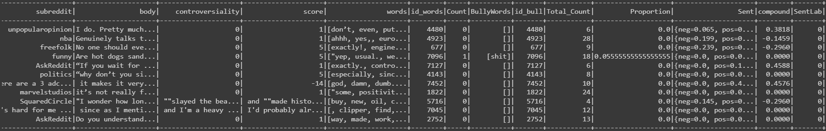
FINAL LABELLED DATA

Slide 16
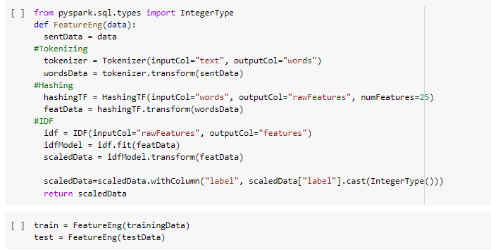
FEATURE ENGINEERING

Slide 17
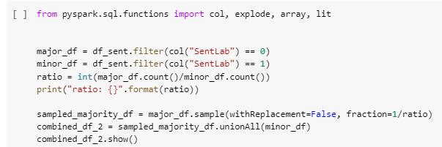
UNDERSAMPLING

Slide 18
MACHINE LEARNING MODELS
LOGISTIC REGRESSION
SUPPORT VECTOR MACHINE
RANDOM FOREST

Slide 19
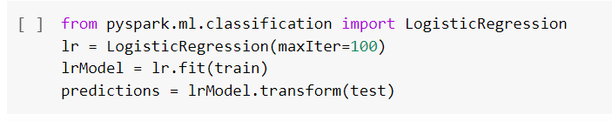
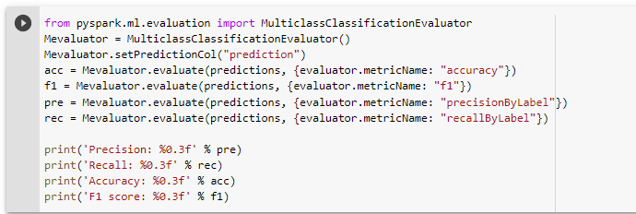
LOGISTIC REGRESSION

Slide 20
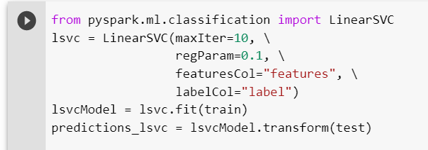
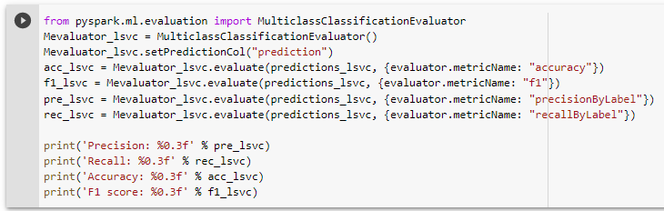
SUPPORT VECTOR MACHINE

Slide 21
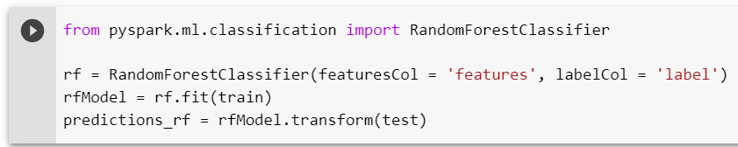
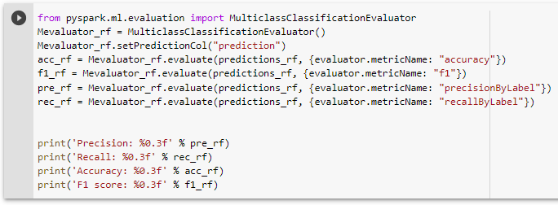
RANDOM FOREST

Slide 22
Evaluation Metric Results - 50k Records
Evaluation | Logistic Regression | SVM | Random Forest
Precision | 0.333 | 0.375 | 0.333
Recall | 0.5 | 0.5 | 0.500
Accuracy | 0.438 | 0.5 | 0.438
F1 Score | 0.444 | 0.508 | 0.444

Slide 23
Conclusion
Labelling the unsupervised data based on Sentiment Analysis and offensive proportion
Built machine learning models - Logistic, SVM and Random Forest
The Accuracy, Precision, Recall, F1 for the models were calculated
Future Scope:
Planning to improve the models with datasets from other social media.

Slide 24
THANK YOU!

Slide 25
REFERENCE
https://www.statista.com/topics/1809/cyber-bullying/#topicHeader__wrapper
https://enough.org/stats_cyberbullying
https://medium.com/@junwan01/oversampling-and-undersampling-with-pyspark-5dbc25cdf253
https://stackoverflow.com/
https://www.tutorialkart.com/apache-spark/spark-mllib-tf-idf/

